Slide 1

Small Bank USA
Individual Credit Worthiness: New Applications

Slide 2
Credit Worthiness New Applications
250 new applications – 73% increase
Current “manual” process too long – may loose customers
Consider statistical/machine learning approaches
Balance the human/machine decision making process

Slide 3
Credit Worthiness New Applications
Available information:
data on our last 500 personal loan cycles (credit-data-training.xlsx)
data on our new 250 applications (customers-to-score.xlsx)

Slide 4
Credit Worthiness New Applications
Independent variables for each loan record (prior & new):
Account Balance
Duration of Credit Month
Payment Status of Previous Credit
Purpose
Credit Amount
Value Savings Stocks
Length of current
employment
Instalment percent
Guarantors
Duration in Current address
Most valuable available asset
Age years
Concurrent Credits
Type of apartment
No of Credits at this Bank
Occupation
No of dependents
Telephone
Foreign Worker
We can defer preprocessing until later when using tidymodels

Slide 5
Credit Worthiness New Applications
Outcomes
Training & Testing: “Credit Application Result”
Two-class: “Creditworthy” or “Non-Creditworthy”
New Applications: “Predicted Classification”
Two-class: “Creditworthy” or “Non-Creditworthy”
Probability cutoff set at 0.5, so “Creditworthy” set at > 0.5
A classification problem
In-house data: fairly clean

Slide 6
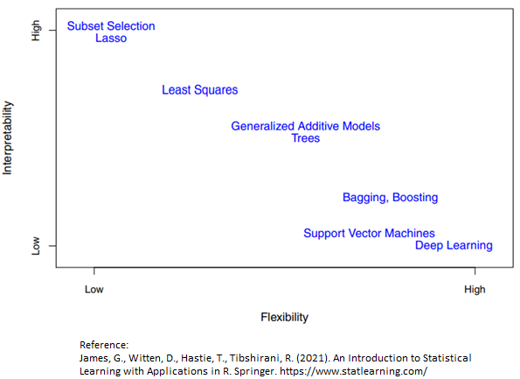
Credit Worthiness New Applications
Many statistical methods
Picking 3
Logistic Regression
Random Forest
Support Vector Machine

Slide 7
Credit Worthiness New Applications
Overall framework:
Key packages: tidymodels and workflows
Set the train/test split to 70/30
10-fold cross validation – address the class imbalance
Preprocessing in general:
Consider: dummy vars, imputation, decorrelation, normalization, transformation
Accomplished with “step_x” functions e.g., step_normalize(all_predictors()) or step_impute_median(Age_years)
Model parameters:
Logistic Regression: engine to “glmnet” - penalty ?, mixture ?,
Random Forest: engine to “randomforest” - mtry !, trees ?, min_n ?
Support Vector Machine: engine to “kernlab” - cost ?, rbf_sigma ?, margin ?

Slide 8
Credit Worthiness New Applications
For model training:
Define model, recipe, workflow, 25-parameter tuning grid
Conducted all recommended preprocessing using the Tidy Models recommendations
Set the auto tuning parameter selection for each model to “roc_auc”
For model testing:
Simply use each of the best selected training models on the test data
For new data prediction:
We’ll analyze the test data results and pick a model for the 250 new records.

Slide 9
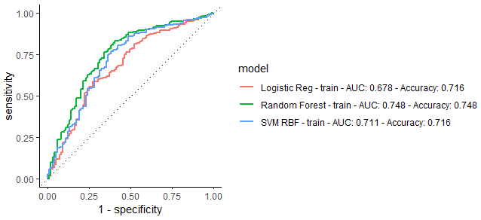
Credit Worthiness New Applications
Training Results

Slide 10
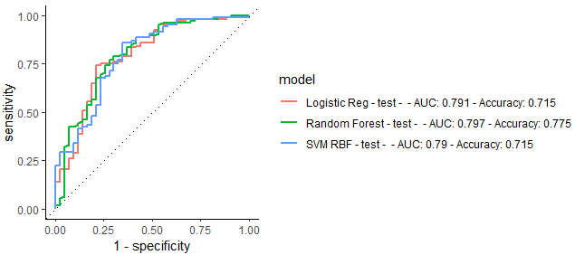
Credit Worthiness New Applications
Testing Results

Slide 11
Credit Worthiness New Applications
Testing Results

Slide 12
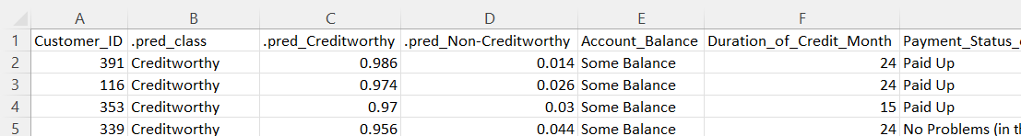
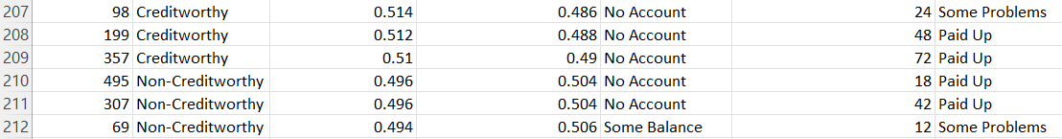
Credit Worthiness New Applications
New Excel file:

Slide 13
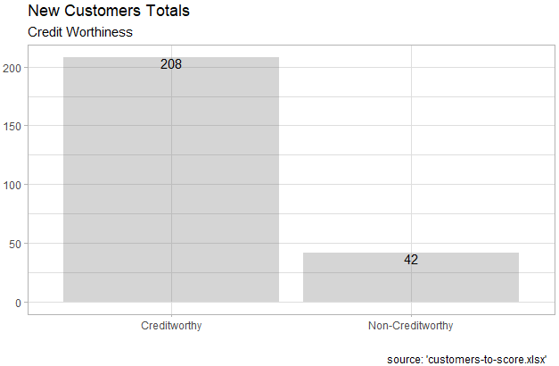
Credit Worthiness New Applications

Slide 14
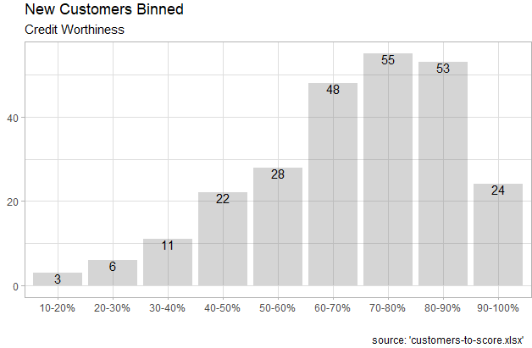
Credit Worthiness New Applications

Slide 15
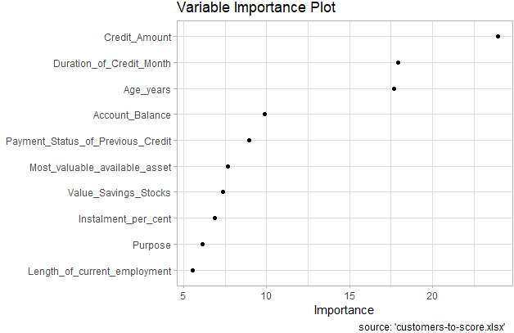
Credit Worthiness New Applications
Model’s “opinion”

Slide 16
Credit Worthiness New Applications
Summary:
Used the Tidy Models and Workflow frameworks to create a very flexible and interpretable classification algorithm
Potential future work: confusion matrixes to measure specific areas of accuracy.

